Slide 1

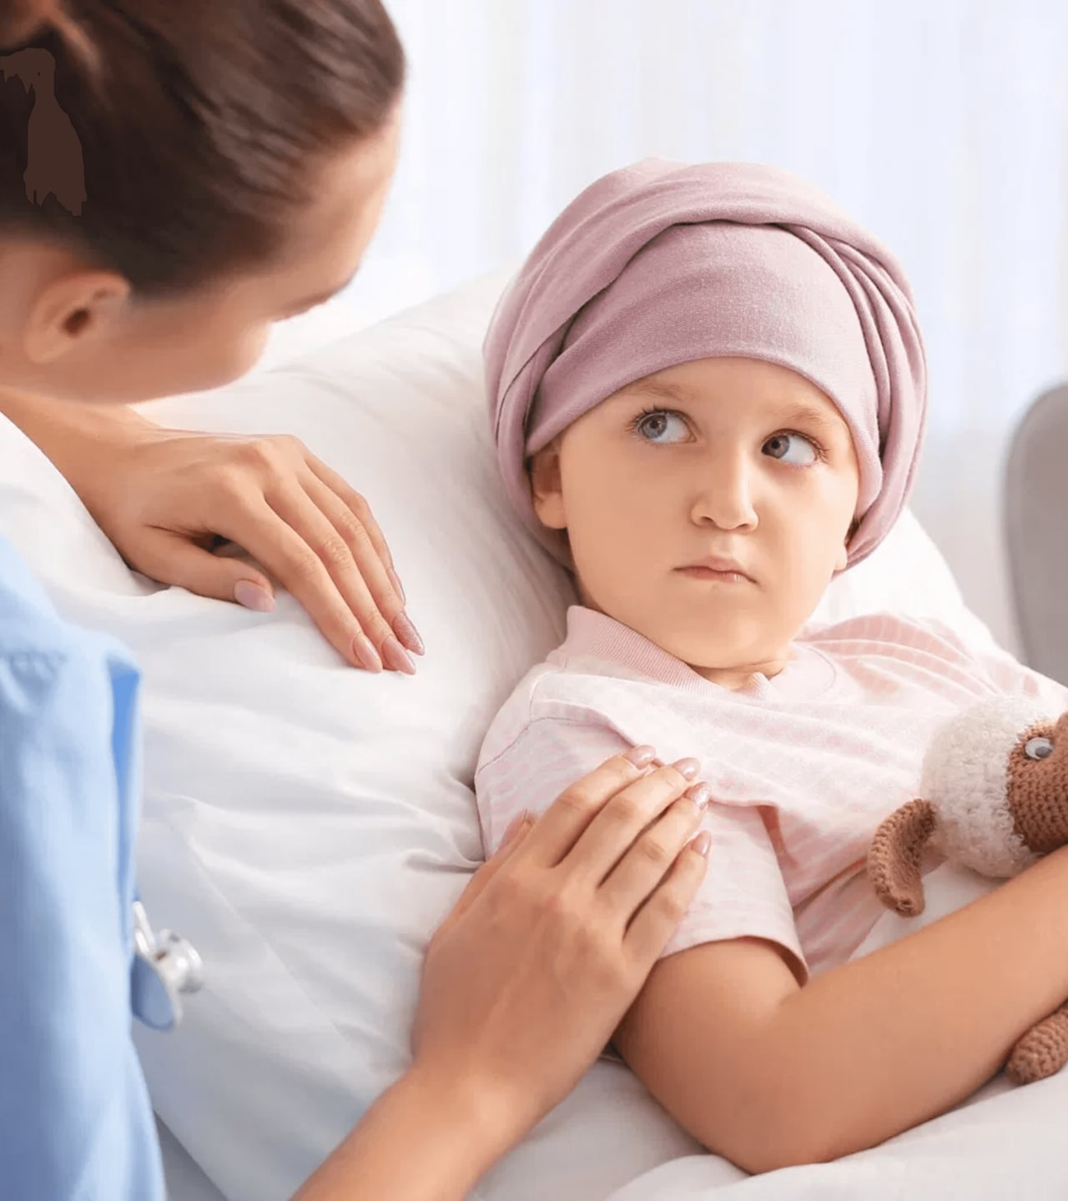
Aoun (عون)
Intelligent Cancer Patient Monitoring System
“Support for Every Step of the Journey”
Prepared by
Mohammad Thaher

Slide 2




The Silent Struggle: Life Between Visits
Beyond the Clinic
Patients face their hardest moments at home, often alone and unmonitored between visits.
"Cancer management happens every day, not just during clinic hours."
The Weight of Uncertainty
Every new symptom brings fear is it a side effect or a sign of deterioration?
OVER 19 MILLION STORIES EVERY YEAR
Disconnected Care
Vital health changes often go unnoticed until the next scheduled appointment.

Slide 3





Aoun: Your Companion in the Dark
Aoun (Support)
A Continuous Presence
Locally Rooted
Empowerment
More than an app a digital hand to hold through the toughest times.
A 24/7 link ensuring you're never truly alone between clinic visits.
A private sanctuary for your health data, keeping personal moments personal.
Turning fear into knowledge through continuous, AI-driven monitoring.
"Because support should never have a closing hour."

Slide 4

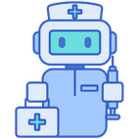


The Patient Experience Pipeline
A Simple Daily Ritual
Invisible Intelligence
Immediate Peace of Mind
Logging symptoms and taking a wellness selfie becomes a moment of mindful self-care.
Sophisticated AI works quietly in the background to analyze risk and facial wellness.
Instant feedback and direct alerts to doctors when support is needed most.
"Bridging the gap between technology and a doctor's timely intervention."

Slide 5

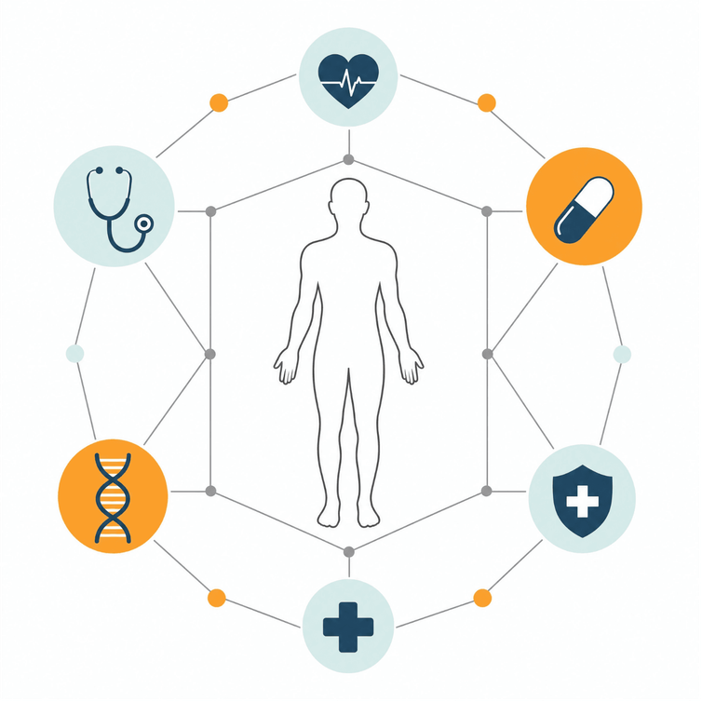


Watching Over You: The ML Risk Engine
A Guardian in Your Pocket
Catching symptom deterioration before it becomes critical.
Analyzing the Subtle Changes
Monitoring 23 clinical features to detect patterns that the human eye might miss.
Your Doctor is Always Close
Automatic High-risk alerts ensure your oncologist is notified the moment you need them.
"Turning 740,000 clinical records into a personalized safety net for every patient."

Slide 6

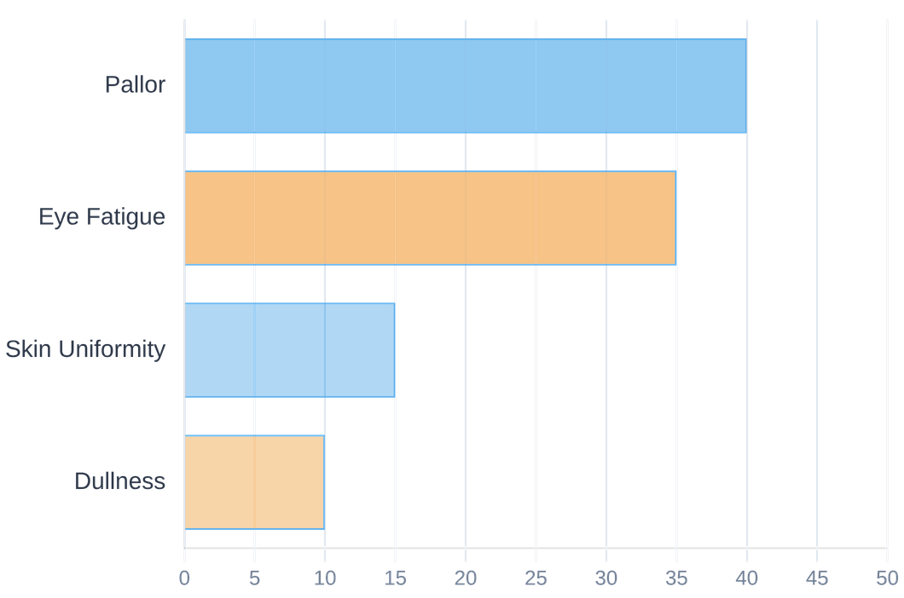


The Mirror of Wellness: Facial Analysis
Seeing Beyond the Surface
Compassionate Tech
No medical hardware needed just a simple daily selfie to track your wellness journey from the comfort of home.
Quantifying physiological signs of illness with compassion.
Objective Care
Quantifying pallor and fatigue through OpenCV and LAB color-space analysis to provide a clear, objective picture of your health.
A New Way to Connect
Sharing your wellness journey with your doctor through the lens of empathy, ensuring they see how you truly feel.
"Technology that understands the human face of illness."

Slide 7






A Trusted Voice: The RAG Chatbot
Always Ready to Listen
An intelligent assistant powered by Mistral-7B, available for your late-night questions and concerns.
Safe and Grounded
"It's like having a knowledgeable friend who is always there when you need clarity."
Answers grounded in NCI/ACS clinical publications and a curated oncology knowledge base
Privacy by Design
VERIFIED MEDICAL KNOWLEDGE
A local AI that learns from you without ever letting your sensitive data leave your device.

Slide 8

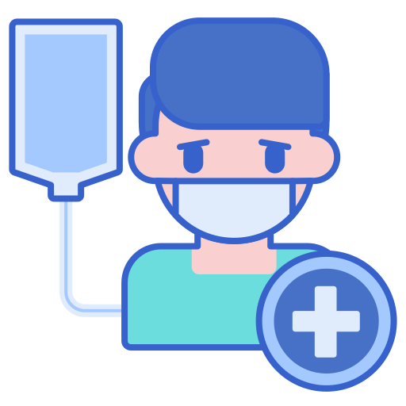

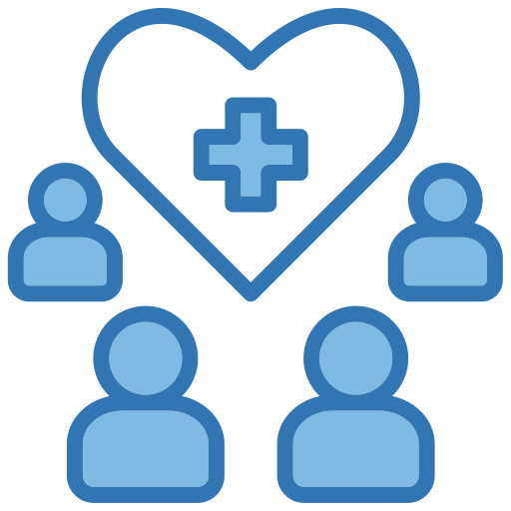
A Unified Circle of Care
For the Patient
For the Doctor
For the Team
Daily rituals of self-care and logging
Triage-sorted view of urgent needs
Seamless flow of vital information
Instant emergency guidance
ML prediction feedback
Closing the loop on patient care
Peace of mind between visits
Real-time alerts for critical changes
Ensuring no one feels forgotten
A unified focus on the journey
"Ensuring no patient ever feels forgotten between clinic visits."

Slide 9

Validated with Care
27/28
<200ms
100%
REQUIREMENTS MET
ML RESPONSE TIME
LOCAL DATA PRIVACY
VALIDATION PILLAR
METHODOLOGY
OUTCOME FOR THE PATIENT
Clinical Reliability
Black Box Testing
TRUST
— All core care flows validated
Speed of Support
Local Inference
PEACE
— Instant results when seconds count
Data Sanctuary
PostgreSQL Architecture
SAFETY
— Personal moments stay private
"Technical excellence is our foundation for your peace of mind."

Slide 10




A Future of Even Deeper Support
The Rhythm of Life
A Global Voice
Integrating wearables to monitor heart rate and sleep patterns, providing a more intimate understanding of your daily health.
Bringing Aoun to more patients with multi language support, ensuring everyone can access care in their own language.
Seamless Connection
Evolving with You
Linking directly with hospital Electronic Health Records (EHR) for a truly integrated and effortless care journey.
Moving toward real-time video wellness analysis for even more sensitive and dynamic physiological tracking.
"Evolving Aoun into a comprehensive, global oncology monitoring standard."

Slide 11



Conclusion: You Are Never Alone
Aoun bridges the gap in oncology care with intelligence and empathy, ensuring that every patient has a continuous circle of support.
The Missing Link
A Vision of Hope
The Future of Care
Transforming reactive monitoring into a proactive, empathetic ecosystem.
Empowering patients to take control of their journey with confidence.
Where technology serves the human spirit, one patient at a time.
Aoun: Support for Every Step of the Journey.

